Slide 1

Introduction to Cloud Computing
Week 13
Azure Cloud Infrastructure, Monitoring, DevOps and Governance.
CS-4037
Muhammad Sudais
muhammad.sudais.v@nu.edu.pk

Slide 2
CHAPTER 11 cloud Infrastructure, DevOps, and Monitoring in Azure
|LEARNING MICROSOFT AZURE

Slide 3
Introduction
Overview:
Understanding Azure’s offerings in cloud infrastructure and development.
Key focus on automation, scalability, and efficient monitoring practices.
Objectives:
Discover benefits of cloud-native architecture.
Explore DevOps practices for continuous delivery.
Learn how Azure facilitates effective monitoring and management.

Slide 4
Why Cloud-Native Infrastructure?
Definition: Architecture built to fully leverage cloud capabilities, focusing on flexibility, scalability, and resilience.
Key Characteristics:
Microservices-based
API-driven
Automation-centric
Traditional Infrastructure Limitations:
Expensive and inflexible
Difficult to scale
High risk of downtime and data loss
Benefits:
Scalability: Automatic resource management based on demand.
Reliability: Improved disaster recovery with built-in redundancies.
Cost Efficiency: Pay-as-you-go pricing reduces upfront capital expenses.
Global Reach: Easily deploy services across different geographic regions.

Slide 5
Core Components of Cloud Infrastructure
Compute Services: Virtual Machines, Azure App Service, Azure Kubernetes Service (AKS).
Storage Solutions: Azure Blob Storage, Azure Data Lake, Azure SQL Database.
Networking Services: Virtual Networks, Load Balancers, Azure Front Door.
Management Tools: Azure Resource Manager, Azure Monitor, Azure Automation.

Slide 6
On-Premises vs. Cloud-Native: A Detailed Comparison
On-Premises Infrastructure:
Costs: High capital investment and maintenance.
Scalability: Limited and time-consuming.
Disaster Recovery: Complex and expensive.
Cloud-Native Infrastructure:
Costs: Pay-as-you-go, reduced maintenance.
Scalability: Effortless and automatic.
Disaster Recovery: Integrated solutions with quick recovery times.

Slide 7
Introduction to Microservices Architecture
Concept: Dividing applications into small, independent services.
Advantages:
Independent scaling and deployment.
Enhanced fault tolerance.
Technology-agnostic: Services can use different programming languages or databases.
Use Cases: Netflix, Amazon, and Uber.

Slide 8
Containerization in Azure
What is Containerization?
Packaging software with its dependencies into a 'container' for easy deployment.
Technologies: Docker, Kubernetes, and Azure Container Instances.
Azure Kubernetes Service (AKS):
Automated deployment, scaling, and operations of Kubernetes.
Simplifies container orchestration in production environments.

Slide 9
Understanding Orchestration
Definition: Coordinating and managing container deployment at scale.
Kubernetes Functions:
Load Balancing: Distributes network traffic evenly across services.
Auto-Scaling: Automatically adjusts the number of running containers.
Self-Healing: Replaces or restarts failed containers automatically.

Slide 10
Modern Application Development with DevOps
Definition of DevOps:
Cultural shift that unifies development (Dev) and operations (Ops) teams.
Key Principles:
Automation: Automate repetitive tasks, including testing and deployments.
Collaboration: Continuous feedback and integration between teams.
Continuous Improvement: Regular updates and enhancements.

Slide 11
Continuous Integration (CI)
Concept: Integrate code into a shared repository multiple times per day.
CI Pipeline Stages:
Code Compilation: Verifies code builds correctly.
Automated Testing: Unit, integration, and functional tests.
Artifact Storage: Compiled code stored for deployment.
Azure DevOps Tools for CI: Azure Pipelines, GitHub Actions.

Slide 12
Continuous Deployment (CD)
Definition: Automatically deploying code to production after passing CI tests.
CD Pipeline Steps:
Pre-Deployment Approvals: Optional manual checks.
Deployment to Staging: Testing in a production-like environment.
Production Release: Gradual or complete rollout.
Advantages:
Rapid delivery of features and fixes.
Improved product stability and security.

Slide 13
Introduction to Azure DevOps
What is Azure DevOps?
A cloud-based suite of tools for DevOps practices.
Supports the entire software development lifecycle (SDLC).
Key Components:
Collaboration tools to enable teams (developers, project managers, and stakeholders).
Focus on agile methodologies and continuous improvement.

Slide 14
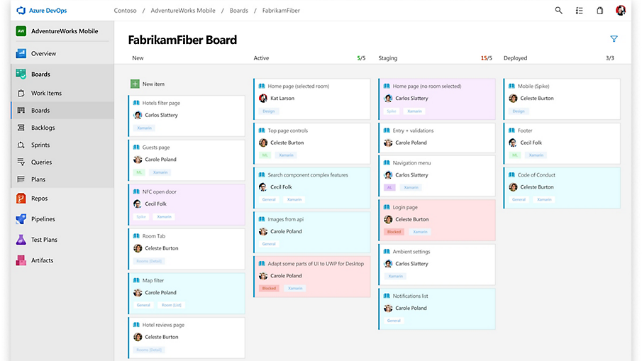
Azure DevOps Dashboard
Overview:
Central hub for managing DevOps projects.
Customizable dashboards to track progress and metrics.
Components of the Dashboard:
Azure Boards: Work items, backlogs, and sprint progress.
Azure Pipelines: Build and release statuses.
Azure Repos: Code repository activity.

Slide 15
Azure Boards
Purpose: Agile project management and planning.
Key Features:
Work Items: Create and manage user stories, tasks, and bugs.
Backlogs: Prioritize tasks for sprints.
Sprints: Plan and track progress of work in iterations.
Integration with Azure Repos:
Automatically link commits and pull requests to work items for traceability.
Ideal For: Teams practicing Scrum or Kanban methodologies.

Slide 16
Azure Pipelines
Purpose: Implement Continuous Integration/Continuous Deployment (CI/CD).
Key Features:
Build Automation: Compile code, run tests, and create artifacts.
Release Automation: Deploy applications to various environments.
Multi-platform Support: Works with any language and cloud.
Use Case Example: Automatically trigger builds on code commits, ensuring fast feedback loops.

Slide 17
Azure Repos
Purpose: Version control system for source code.
Key Features:
Git Repository: Supports both centralized and distributed version control.
Branch Policies: Set up code quality gates before merging code.
Pull Requests: Facilitate code reviews and discussions.
Benefits:
Collaboration on code changes with a structured review process.

Slide 18
Azure Test Plans
Purpose: Manage and execute tests for quality assurance.
Key Features:
Test Management: Create and manage test cases and suites.
Manual Testing: Execute tests and log results.
Automated Testing Integration: Link automated tests with CI/CD pipelines.
Benefit: Ensures quality by identifying defects early in the development process.

Slide 19
Built-in Analytics and Reporting
Analytics Features:
Dashboards: Visualize project health and team performance.
Reports: Generate reports on build success rates, release quality, and team velocity.
Benefits:
Data-driven decision-making helps identify bottlenecks and improve processes.
Track team performance against KPIs for accountability.

Slide 20
Azure DevOps: Cloud vs. On-Premises
Azure DevOps Services (Cloud):
Scalability: Easily scale with team size and project complexity.
Automatic Updates: Benefit from new features and security updates automatically.
Azure DevOps Server (On-Premises):
Control: Complete control over your infrastructure and compliance.
Customization: More options for customization to fit specific organizational needs.
Decision Factors: Choose based on scalability needs versus compliance requirements.

Slide 21
Azure DevTest Labs
Purpose: Quickly create and manage environments for testing and development.
Key Features:
Cost Management: Set policies to control VM usage and costs.
Custom Images: Use custom images to speed up environment setup.
Benefits:
Fast provisioning of test environments improves development speed.
Enhanced security through integration with Azure Active Directory (Entra ID).

Slide 22
GitHub for DevOps
Overview:
GitHub: A leading platform for version control and collaboration.
Popular among open-source communities and education sectors.
Key Features:
Repositories: Store code with version control.
Actions: Implement CI/CD directly within GitHub.
Community: Extensive network for collaboration on open-source projects.
Use Case Example: Educational institutions using GitHub to teach version control and collaborative software development.

Slide 23
GitHub for Education
Applications in Education:
Teaching version control and collaboration through real-world projects.
Facilitating student participation in open-source initiatives.
Benefits:
Encourages hands-on learning and engagement.
Provides students with practical experience in software development.

Slide 24
Infrastructure Automation with IaC (Infrastructure as Code)
What is IaC?
Managing and provisioning computing resources using machine-readable configuration files.
Tools in Use:
Azure Resource Manager (ARM): Declarative templates for Azure resources.
Terraform: Open-source IaC tool supporting multiple cloud providers.
Bicep: Simplified syntax for ARM templates.
Benefits:
Version control for infrastructure.
Automated and repeatable deployments.
Reduced risk of human error.

Slide 25
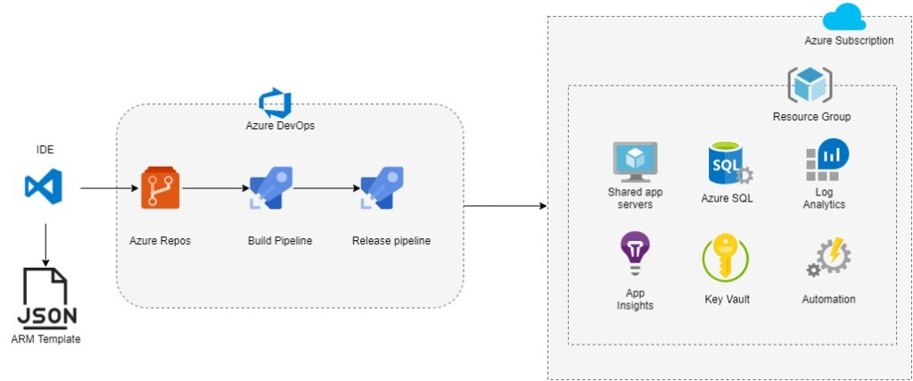
IaC Workflow
Process Flow:
Design: Define infrastructure requirements.
Code: Write infrastructure configuration.
Implement: Deploy infrastructure using scripts.
Update: Modify configurations as needed.
Outcome: Faster and more reliable infrastructure deployments.

Slide 26
Azure Resource Manager (ARM)
Overview:
A management framework for deploying and managing Azure resources.
Deployment and Management: Uses declarative JSON templates.
Features: Resource grouping, role-based access control, and tags for organization.
Components of ARM Templates:
Parameters: Input values at deployment time for reusability.
Variables: Internal values used throughout the template.
Functions: Custom logic defined within the template.
Resources: Specification of resources to deploy.
Outputs: Returns values upon deployment completion.
Challenges of Using ARM Templates:
Complexity of JSON: Hard to read, author, and debug.
Syntax Overhead: JSON structure can be cumbersome.
Learning Curve: Difficulty for new users.

Slide 27
Azure Bicep
 | ARM | Bicep
Syntax | JSON | Simplified syntax
Integration | Deep Azure integration | Focused on ease of use
Features | Rich features | Streamlined for simplicity
Compatibility | Widely used | Compatible with Kubernetes and ARM
A domain-specific language (DSL) for Azure resource deployment.
Advantages of Bicep
Simpler syntax, improved readability, and modularity.
Transpilation to ARM
Bicep templates are converted to ARM templates for deployment.

Slide 28
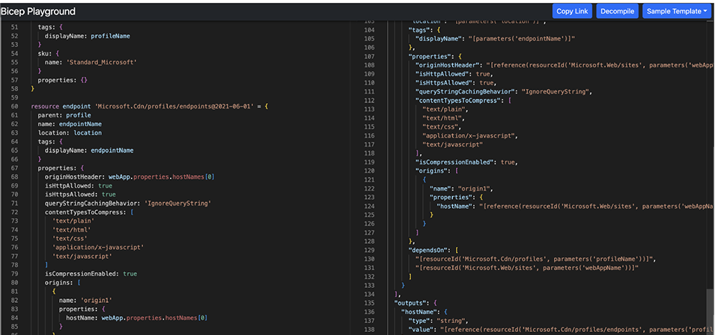
Bicep vs ARM

Slide 29
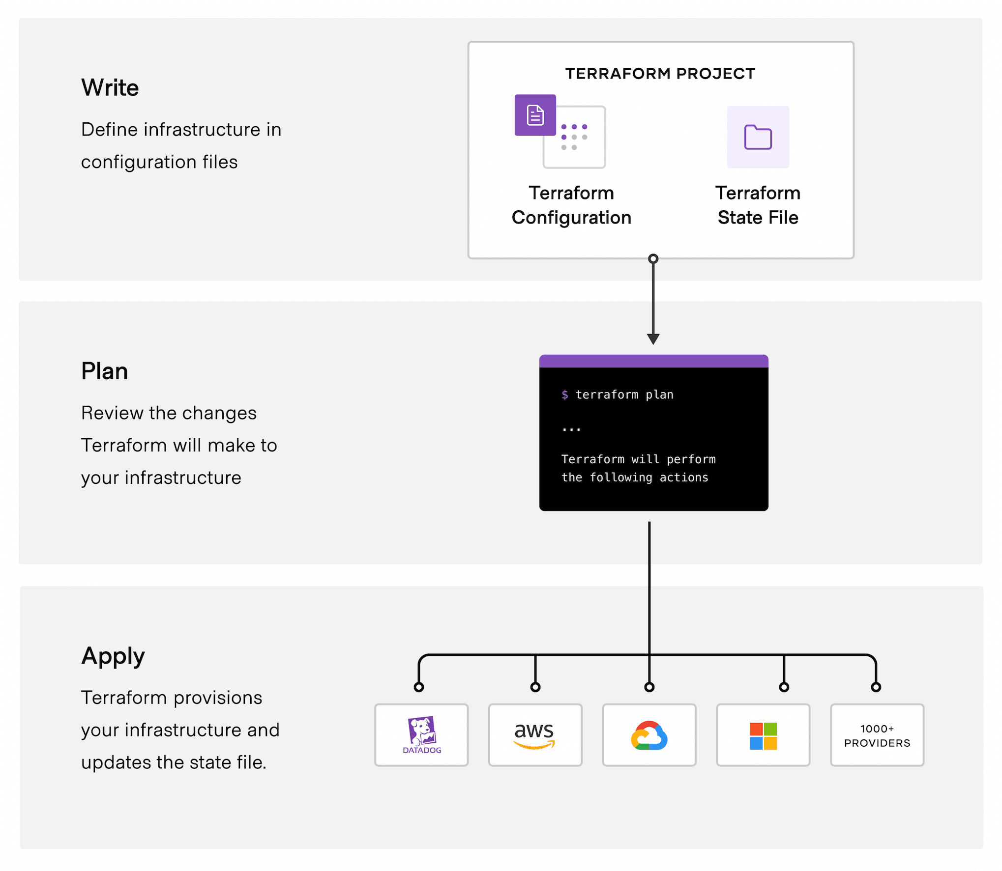
Terraform
Use Cases for Terraform
Multi-cloud infrastructure deployment.
Large-scale deployments.
Benefits of Terraform
State management, clear preview of changes.
Flexibility for different cloud providers.

Slide 30
CaC & PaC
Configuration as Code (CaC)
Managing configurations through source code.
Benefits
Version control, reusability, and automation.
Enables collaboration and auditing.
Policy as Code (PaC)
Defining policies using code for compliance and security.
Benefits
Enforces standards, improves governance.
Implementation in Azure
Use of Azure Policy for managing compliance and security rules.

Slide 31
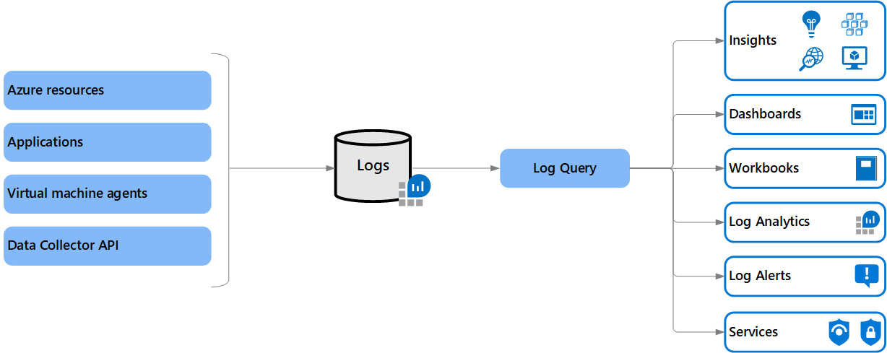
Introduction to Azure Monitoring Tools
Importance of monitoring tools in facilitating IT operations.
Benefits: Reduced costs, improved performance, reliability, and security of cloud infrastructure.

Slide 32
Azure Monitoring Service
Azure Monitor:
Overview:
Centralized tool for monitoring Azure applications and resources.
Provides real-time visibility into health and performance.
Key Features:
Tracks application and service availability.
Configurable alerts via various methods.
Integrates with event-driven services for proactive issue resolution.
Application Insights
Subcomponent of Azure Monitor focused on application metrics and telemetry.
Capabilities:
Observes infrastructure impacting application performance.
Identifies user-related issues and provides insights.

Slide 33
Azure Monitoring Service
Azure Log Analytics
Gathers performance data from applications and infrastructure.
Use Cases:
Identifies and troubleshoots issues impacting cloud resources.
Aggregates logs for comprehensive analysis.
Azure Network Watcher
Monitors networking infrastructure for cloud workloads.
Benefits:
Diagnoses and visualizes networking architecture.
Identifies issues and security risks in network configurations.
Azure Advisor
AI-powered service providing customized suggestions.
Key Features:
Offers performance improvements, cost reductions, and security enhancements.
Acts as an assistant for optimizing Azure resources.

Slide 34
CHAPTER 12 Cloud Management and Governance in Azure
|LEARNING MICROSOFT AZURE

Slide 35
Cloud Management and Governance in Azure
In any cloud journey, establishing a governance framework for the environment and workloads is essential before developing a migration strategy.
Organizations often have existing policies and rules in their on-premises environments that can be optimized and integrated with cloud governance.
Without proper governance, organizations face potential risks, including data security breaches, system integration issues, and challenges in asset deployment.
Aligning cloud adoption with governance practices or creating a dedicated governance team is crucial for ensuring that hybrid environments adhere to organizational policies, compliance obligations, and security best practices.

Slide 36
Key Reasons for Cloud Management and Governance
Effective Management of Cloud Resources: Enables organizations to deploy, configure, and utilize resources efficiently. This encompasses monitoring performance, troubleshooting, and scaling resources according to demand.
Compliance with Regulatory Standards: Ensures that cloud resources align with regulations such as GDPR, HIPAA, and PCI DSS, preventing costly penalties and safeguarding sensitive data.
Consistent Organizational Policies: Aligns cloud resources with corporate policies, including security controls, data retention, and cost management practices, which help reduce risks and maintain operational consistency.
Optimized Cloud Cost Management: Monitors usage to identify underutilized resources and implements cost-saving measures, enhancing overall cost efficiency.
Enhanced Security and Risk Management: Involves the application of security controls and risk management practices to identify and mitigate vulnerabilities, enforce access controls, and maintain compliance.
Disaster Recovery Management: Ensures robust disaster recovery and business continuity strategies are in place, allowing for quick restoration of cloud resources during disruptions.
As organizations increasingly adopt multi-cloud environments, standardized governance practices become vital. These practices not only foster effective resource management but also automate routine tasks like deployment and configuration, thus enhancing operational efficiency.

Slide 37
Azure Resource Manager (ARM)
Overview:
Azure Resource Manager (ARM) is a core tool for managing and deploying Azure resources.
It allows organizations to create, update, and delete resources uniformly, utilizing declarative templates to define the desired resource states.
ARM simplifies the management of complex cloud environments while enhancing security and compliance.
Features:
Unified Resource Management: Manage resources across various Azure services and automate deployment, configuration, and scaling tasks.
Infrastructure as Code (IaC): Utilize ARM templates, Azure Bicep, or Terraform for automating infrastructure deployments.
Role-Based Access Control (RBAC): Manage access permissions for users and groups, ensuring secure and compliant resource management.

Slide 38
Azure Resource Manager (ARM)
Managing and Organizing Resources Using Azure Resource Groups
Organization of Azure Resources: Resources can be grouped by function, application, or environment, facilitating easier management and visibility.
Access Control Management: Azure administrators can define roles and assign permissions, ensuring that governance and compliance requirements are met.
Resource Monitoring: Monitor performance and reliability within resource groups, setting up alerts for specific conditions to proactively address issues.
Automation of Management Tasks: Leverage Azure Automation, Functions, and Logic Apps to automate repetitive tasks, improving efficiency and reducing manual efforts.
Cost Management: Resource groups help track costs associated with various resources, aiding in cost optimization and waste reduction.

Slide 39
Azure Resource Locks
Azure resource locks protect cloud assets from accidental deletion or modification.
There are two main lock types:
ReadOnly: Prevents all users from modifying or deleting resources while allowing read access.
CannotDelete: Allows authorized users to read and modify resources but prohibits deletion.
Resource locks follow a parent-child hierarchy, meaning if a lock is applied at the resource group level, all contained resources inherit the same lock.

Slide 40
Azure Blueprints
Azure Blueprints provide predefined templates that help organizations deploy compliant cloud environments efficiently.
Features:
Standardization of Cloud Resources: Automate the deployment of standardized resources adhering to organizational standards and compliance requirements.
Integration with CI/CD Pipelines: Manage blueprints as code for integration with Azure DevOps, facilitating version control and collaboration.
Artifact Management: Each blueprint consists of artifacts like Azure RBAC roles, policies, and resource groups, enabling the creation of compliant cloud infrastructures.

Slide 41
Azure Monitor for Monitoring and Reliability
Overview:
Azure Monitor is a comprehensive cloud-based monitoring service provided by Microsoft Azure
It enables organizations to track the performance and health of their applications and infrastructure.
It offers insights into application health, allowing proactive identification and resolution of issues.
Key Features:
Centralized Monitoring: Streamlines monitoring across multiple Azure resources, reducing operational complexity.
Real-Time Insights: Quickly diagnose issues before they escalate, ensuring high availability of applications and services.
Customizable Dashboards: Create dashboards to visualize essential metrics and KPIs in a unified view.
Monitoring Alerts: Set up alerts based on specific metrics and thresholds for immediate notifications on issues.
Data Collection and Visualization: Azure Monitor collects telemetry data such as metrics, logs, changes, and traces from various sources. This data can be analyzed using Azure Log Analytics and visualized through tools like Power BI and Grafana.

Slide 42
Azure Automation
Overview:
Azure Automation is a cloud-based service that automates repetitive and time-consuming tasks related to Azure resource management.
It aims to streamline workflows and reduce manual effort.
Key Features:
Automation of Repetitive Tasks: Automates tasks like VM provisioning, configuration management, and system monitoring.
Centralized Management: Simplifies management across Azure and on-premises environments from a single platform.
Scalability: Implements autoscaling configurations to efficiently add or remove resources based on demand.
Use Cases:
Provisioning and Managing Virtual Machines: Automate the creation, management, and scaling of VMs.
Managing Backups and Disaster Recovery: Streamline backup processes and disaster recovery planning.
Monitoring System Health: Automate responses to health alerts and maintain system uptime.
DevOps Automation: Integrate with Azure DevOps to enhance release pipelines and automate testing.

Slide 43
Azure Policy for Compliance and Policy Management
Overview:
Azure Policy is a tool that helps organizations enforce compliance with regulations and governance policies.
It allows the creation, assignment, and management of resource policies.
Key Uses:
Compliance: Ensure resources meet industry regulations and organizational standards.
Security: Enforce security measures to protect resources from unauthorized access.
Governance: Manage and control resources to maintain consistent configurations.
Implementation Steps:
Definition: Create a JSON document that specifies the policy's rules, scope, and effects.
Assignment: Assign the policy to specific scopes like resource groups or subscriptions.
Evaluation: Review resources against the assigned policy to determine compliance.
Best Practices: Start with a small set of policies, gradually adding more as needed, and test policies in a non-production environment before full implementation.

Slide 44
FinOps and Cost Management in Azure
Overview:
FinOps (financial operations) focuses on managing the financial aspects of cloud computing
It optimizes costs while maintaining performance and functionality.
Azure offers various tools to support effective cost management.
Azure Cost Management Tools:
Cost Visibility and Transparency: Provides detailed insights into Azure usage and costs.
Cost Optimization: Identifies cost-saving opportunities, such as turning off idle resources or using reserved instances.
Budget Management: Set budgets and monitor spending to stay within financial constraints.
Cost Forecasting: Estimates future costs based on historical usage patterns.

Slide 45
FinOps and Cost Management in Azure
Best Practices for Azure Cost Management:
Understand usage patterns to identify savings.
Utilize Azure Cost Management for comprehensive resource visibility.
Use reserved instances to save on costs.
Implement autoscaling to optimize resource usage.
Monitor and optimize storage costs.
Key Cost Management Tools:
Azure Cost Management: Detailed analysis and budgeting features for Azure resources.
Azure Advisor: Recommendations for optimizing performance, security, and costs.
Azure Reservations: Prepayment options for significant savings.
Azure Hybrid Benefit: Leverage existing licenses to reduce VM costs.
Azure Budgets: Set and monitor budgets for resources.

